Slide 1
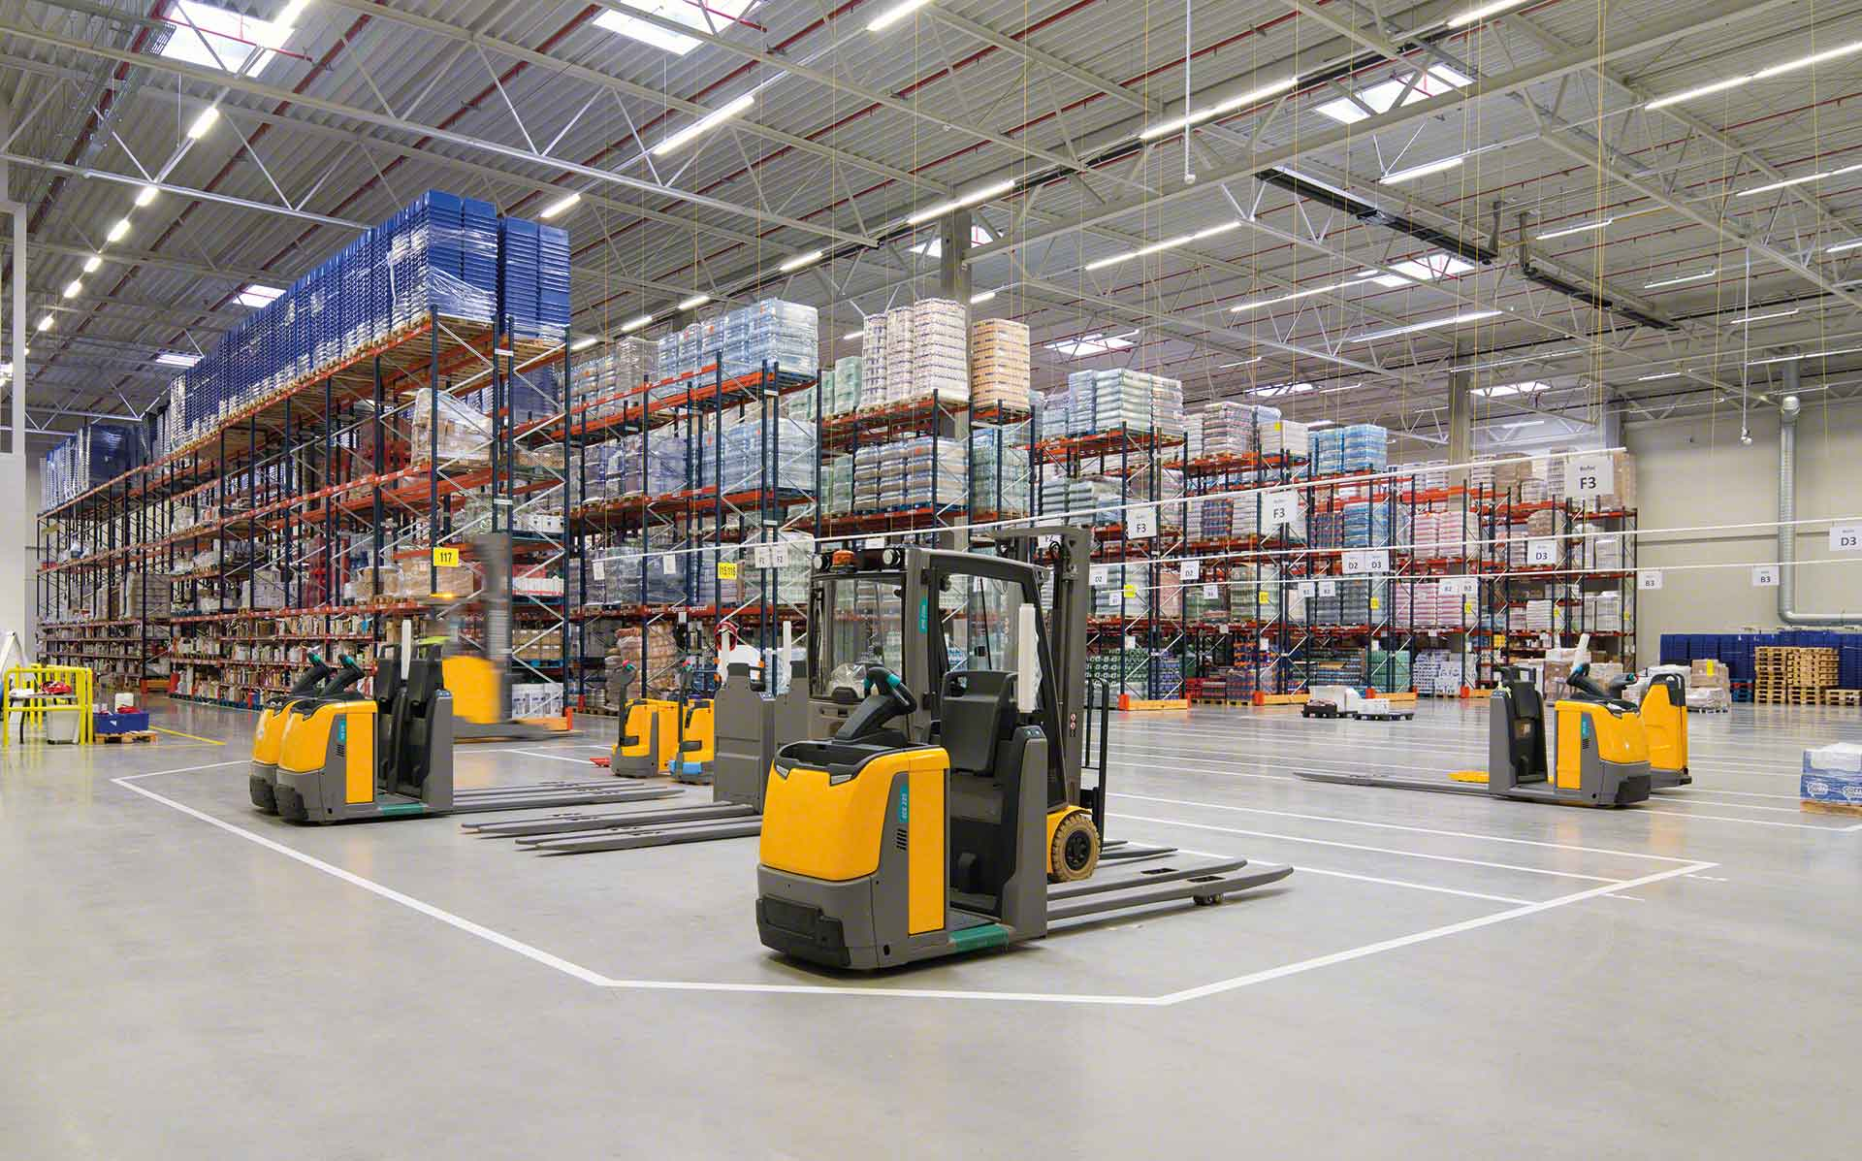

Material Handling KPI
November 2022

Slide 2
Material Handling moves
User | Sum of CYCLE COUNTS | Sum of MAT HANDLE | Sum of TOTAL
erojas | 58 | 8404 | 8462
judelato | 64 | 7845 | 7909
jodelacr | 233 | 4987 | 5229
jtobias | 136 | 4996 | 5134
amiranda | 15 | 5007 | 5022
Grand Total | 506 | 31239 | 31756
Total movements
31,756

Slide 3
Adjustments
Row Labels | Sum of COST | Count of PART
amiranda | 629.34 | 12
erojas | 5329.39 | 53
jodelacr | -4.29 | 186
jtobias | 20554.32 | 123
judelato | 2422 | 56
osirodri | 1336.71 | 64
Grand Total | 30267.47 | 494
Adjustments difference
$30,267.47

Slide 4
Labor intensive
Class not slotted count
144
percentage reduction
82.22%
Labor Intensive
10
percentage reduction
88.37%

Slide 5
Storage efficiency
Low Max
517
percentage reduction
62.12%
Insufficient Spread
618
percentage reduction
62.50%

Slide 6
restock
Date | Count of Part Number
Jul | 1250
Aug | 1783
Sep | 1276
Oct | 1287
Nov | 1308
Dec | 1050
Jan | 1172
Grand Total | 9126
Part Numbers stocked
9126

Slide 7
Empty locations
Row Labels | Count of Part Number
Jul | 1250
Aug | 1783
Sep | 1276
Oct | 1287
Nov | 1308
Dec | 1050
Jan | 1172
Grand Total | 9126
Actual empty locations
356

